Slide 1
Introduction to NodeJS
By Shereef Sakr
Technical Lead Software Developer
Asset Technology Group

Slide 2
What is NodeJS
  Runs Javascript out of the browser environment.
    Based on Chrome V8 engine (Why V8?).
  Opens access to system resources (Files, Network,...).
  Runs over the command-line.
  Platform support is still unixy till now (Linux, Unix, Solaris, Mac OSX).
    Windows is not fully supported.
  uses an event-driven, non-blocking I/O model for supporting highly concurrent programs..... (kalam kebeer !!)

Slide 3
Mission
Node.js is a platform
  built on Chrome's JavaScript runtime for easily building fast, scalable network applications.
  Node.js uses an event-driven, non-blocking I/O model that makes it lightweight and efficient, perfect for data-intensive real-time applications that run across distributed devices.

Slide 4
Basic installation
  Download the suitable package from the http://nodejs.org
    Installers for Windows, Mac OSX exist,
    OR you can compile from source.
      ./configure
      sudo make install

Slide 5
Hello World Demo

Slide 6
Event Driven, IO Blocking Model
  First, formulate the problem
  result = query(’select..’);
  // use result
    This code blocks till the result is returned then continues execution.

Slide 7
Event Driven, IO Blocking Model (2)
  Second, What does “Event Driven, IO Blocking Model” offer
  query(’select..’, function (result) {
  // use result
  });

Slide 8
Event Driven, IO Blocking Model (3)
  result = query(’select..’);
  // use result
  Vs
  query(’select..’, function (result) {
  // use result
  });

Slide 9
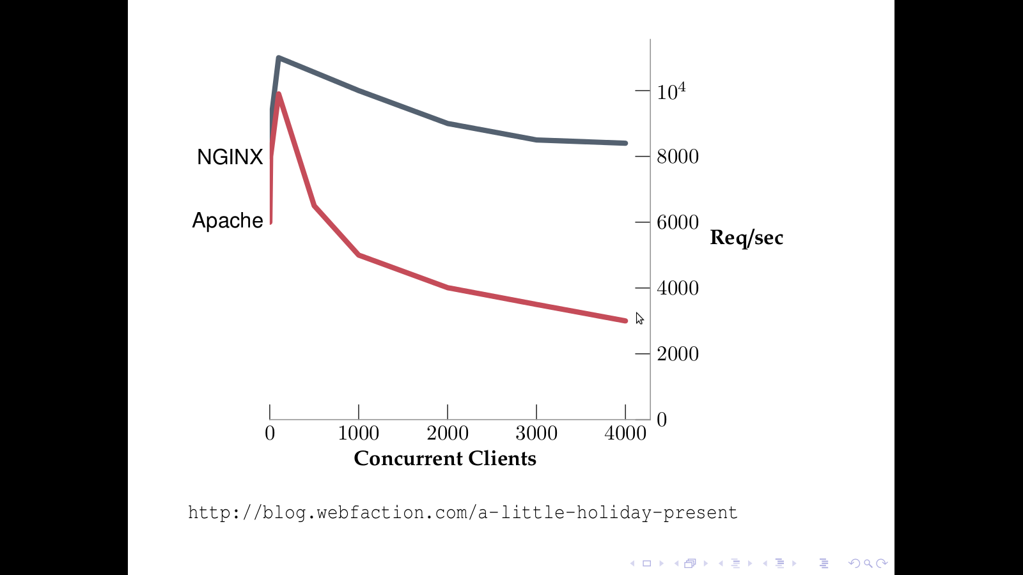

Slide 10
Demos

Slide 11
Node JS Modules
  Standard build in modules are available athttp://nodejs.org/api/index.html
    stdio, fs, http, os,...
  Many third party modules are provided:
    For Data access: mysql.
    For Web Development: expressjs.
    …..
  Many modules exist in a repository on the Internet, and can be used via npm (Node Package Manager).
  And you can develop your own.

Slide 12
NodeJS Modules Demo

Slide 13
NodeJS IDE options
  Eclipse
    https://github.com/ry/node/wiki/Using-Eclipse-as-Node-Applications-Debugger
  NIDE
    Web based IDE
    Implemented in NodeJS (Javascript+ExpressJS)
    Installation
      sudo npm install -g nide
      mkdir nide_proj
      nide init

Slide 14
Further Notes on NodeJS
  Still in beta, v0.6.12.
  Not unusual that NodeJS process crashes.
    Monitoring tools like “monit” are used to monitor the node process and starts it again if it crashes.
  Node web applications are hosted behind a web server like “NGINX”.
    Should be removed when node is stable enough.
  Due to its nature, it does not benefit from multi core processors.
  Despite this, it is used by Microsoft, ebay, LinkedIn and Yahoo.

Slide 15
ExpressJS

Slide 16
How to start with ExpressJS
  So Simple
    npm install -g express
    express ./expressjs_sample
    npm install -d
    node app.js

Slide 17
ExpressJS Live Demo

Slide 18
Thanks.
?

